Slide 1

AI & Data Science Training Program
ENG : Youssef Elbadry

Slide 2
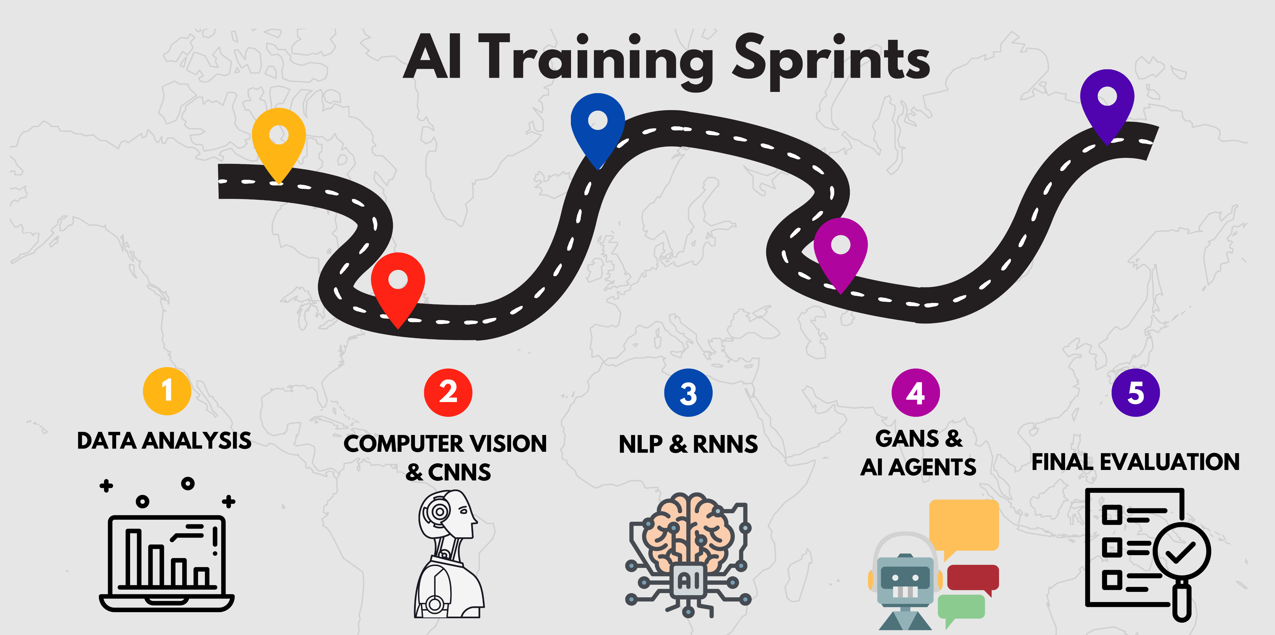

Slide 3
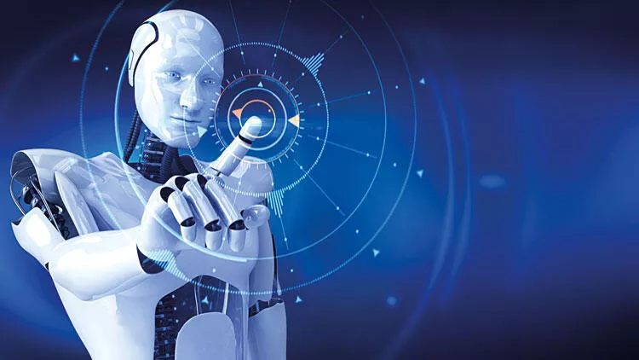
1-Intro About Training

Slide 4
Introduction:
AI & Data Science Training Program
Sprint-Based Learning – From Fundamentals to Advanced Deployment
4 Weeks | 4 Sprints | Hands-On Projects | Real-World Skills
Why Sprint-Based Learning?
Bullet Points:
Rapid, focused learning to simulate real-world deadlines.
Project-based to build portfolio & boost employability.
Weekly feedback loops for continuous improvement.
Encourages consistency, collaboration, and LinkedIn visibility.

Slide 5
Overview of the 4-Week Roadmap
📅 Weekly Sprint Structure
Week | Focus Area | Main Deliverable
1 | Data Analysis | Data Analysis Project + Deployment
2 | Computer Vision (CNN) | CNN Projects + Streamlit/Flask Deployment
3 | NLP & RNN | NLP Projects + Streamlit/Flask Deployment
4 | Advanced Topics | Study GANs & AI Agents + Mini Capstone

Slide 6

2-Sprint 1 – Data Analysis

Slide 7
📊 Sprint 1: Exploratory Data Analysis
Objectives:
Understand dataset structure
Clean, visualize, and interpret data
Use Pandas, Matplotlib, Seaborn, and Plotly
Deliverable:
Full EDA project
Outcome:
Interactive visual report shared on LinkedIn and GitHub.
Tools:
Pandas, NumPy, Matplotlib, Seaborn, Plotly
DBMS
Power BI

Slide 8
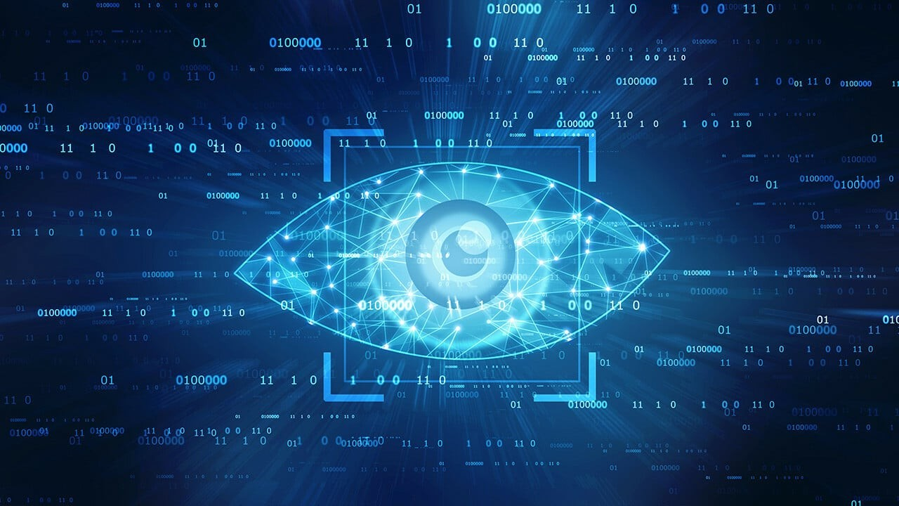
3-Sprint 2 – Computer Vision with CNN

Slide 9
🧠 Sprint 2: Deep Learning – CNN & Computer Vision
Projects:
Brain Tumor Classification & Segmentation
Parking Space Counter
Car License plate detection
Tools:
Pre-Trained Models (Resnet – Efficientnet – Googlenet – Unet)
Yolo & Roboflow
Tensorflow – Keras – Hugging Face – Pytorch
Deployment (Streamlit – Flask )
Deliverables:
3 working deployed apps + LinkedIn posts
GitHub repo with README and usage instructions

Slide 10
1. Brain Tumor Classification & Segmentation
Objective:
Detect and classify brain tumors (Benign, Malignant, or None)
Segment tumor regions from MRI images
Datasets:
https://www.kaggle.com/datasets/mateuszbuda/lgg-mri-segmentation
https://www.kaggle.com/datasets/navoneel/brain-mri-images-for-brain-tumor-detection
Tools & Models Used:
Classification: ResNet, EfficientNet, GoogleNet
Segmentation: U-Net
Libraries: TensorFlow, Keras, PyTorch
Deployment: Streamlit or Flask web app

Slide 11
2. Parking Space Counter
Objective:
Detect empty vs occupied parking slots from video feed
Video: Choose any video you want
Tools & Models Used:
Preprocessing with OpenCV
Detection via YOLOv8 with custom-trained data on Roboflow
Frame-by-frame space counting logic
Deployment: Flask for real-time video stream interface

Slide 12
3. Car License Plate Detection & OCR
Objective:
Detect vehicles and extract license plate text
Video: Choose any video you want
Tools & Models Used:
YOLO for detection (trained with Roboflow dataset)
EasyOCR / Tesseract for license number recognition
OpenCV for image preprocessing
Flask or Streamlit to deploy a live detection interface

Slide 13
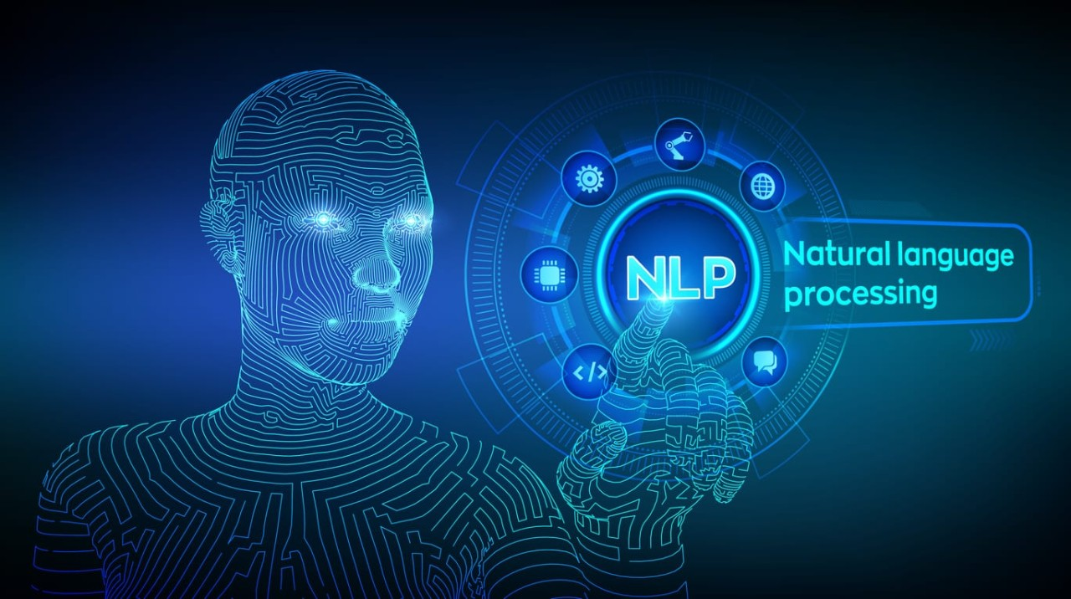
4-Sprint 3 – NLP & RNN

Slide 14
🗣️ Sprint 3: Natural Language Processing & RNNs
Projects :
Sentiment Analysis
RAG System
Text Summarizer& Question Answering
Skills:
Tokenization, vectorization, sequence modeling
Transformer models: BERT, RoBERTa
LSTM / GRU for sequence generation
Deployment:
Streamlit apps with live user input support
Optional: Flask API + frontend

Slide 15
1. Sentiment Analysis
Objective:
Analyze customer feedback or product reviews to determine sentiment (Positive, Negative, Neutral)
Datasets:
https://www.kaggle.com/datasets/jp797498e/twitter-entity-sentiment-analysis/data
Tools & Models Used:
Traditional: TF-IDF + LSTM
Transformer-based: BERT, RoBERTa (via Hugging Face)
Libraries: Scikit-learn, Transformers, PyTorch/TensorFlow
Deployment: Streamlit for real-time text input + sentiment output

Slide 16
2. RAG System (Retrieval-Augmented Generation)
Objective:
Build a Q&A system that retrieves context from documents and generates answers using a transformer model
Tools & Models Used:
Embedding + FAISS / ChromaDB for retrieval
LangChain or Hugging Face pipeline for generation (e.g., using BART/GPT)
Documents stored in vector DB
Deployment:
Streamlit or Flask for user input → answer generation
Upload custom PDFs for personalized QA

Slide 17
3. Text Summarizer & Question Answering
Objective:
Summarize long articles and answer questions based on them
Tools & Models Used:
Summarization: T5, BART
QA: BERT fine-tuned / Hugging Face pipeline
Tokenization and encoding via Hugging Face
Streamlit/Flask for interaction
Deployment:
Upload or paste large text
Get summarized version
Ask questions about the content with accurate answers

Slide 18
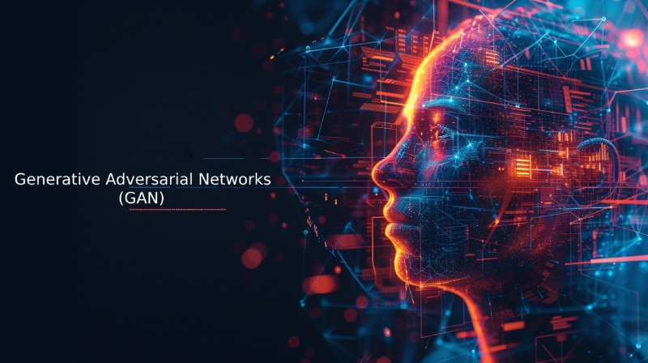
5-Sprint 4 – Advanced Topics

Slide 19

🔬 Sprint 4: Generative AI & Agents
Projects :
n8n Workflow → Optional
Make Workflow →Optional
Text-To-Image Project

Slide 20
3. Text-to-Image Project – AI Image Generator
Objective:
Generate images from text prompts using Stable Diffusion or DALL·E models
Tools Used:
Hugging Face Diffusers, OpenAI’s DALL·E, or Replicate API
Custom UI with Streamlit for input prompt + image output
Optional: Use Gradio if preferred
Deployment:
Web app to input a prompt like "A futuristic city in the clouds" → Get AI-generated image
Ability to download or share image

Slide 21

Project Submission Process

Slide 22
📥 Project Submission Instructions
Every Week:
Submit a Google Form with:
GitHub Repo URL (Clean code + README)
LinkedIn Post URL (With @Instant tagged)
Why LinkedIn?
Build personal branding
Show real proof of work
Engage with the tech community

Slide 23
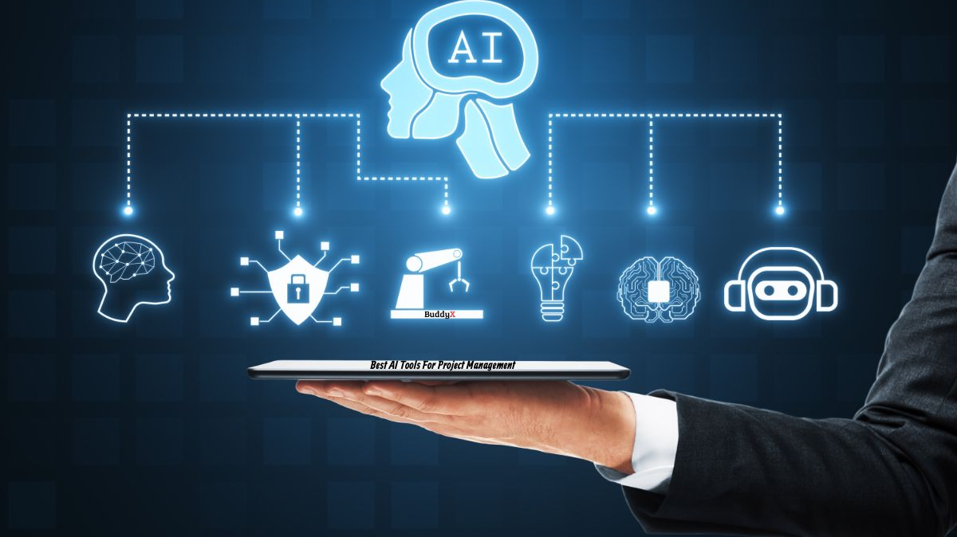
What You Will Achieve

Slide 24
🎓 By the End of This Training
Hands-on portfolio with 7+ deployed projects
Knowledge of EDA, CNN, NLP, RNN, GANs, Agents
Streamlit and Flask deployment mastery
Visible professional footprint on LinkedIn + GitHub
Ready to apply for internships and jobs confidently

